Slide 1
Digital Therapies (Project Chamai and other online resources)

Slide 2
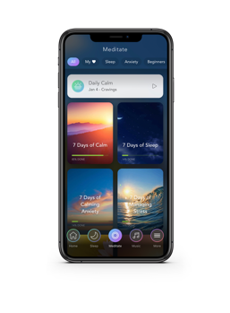
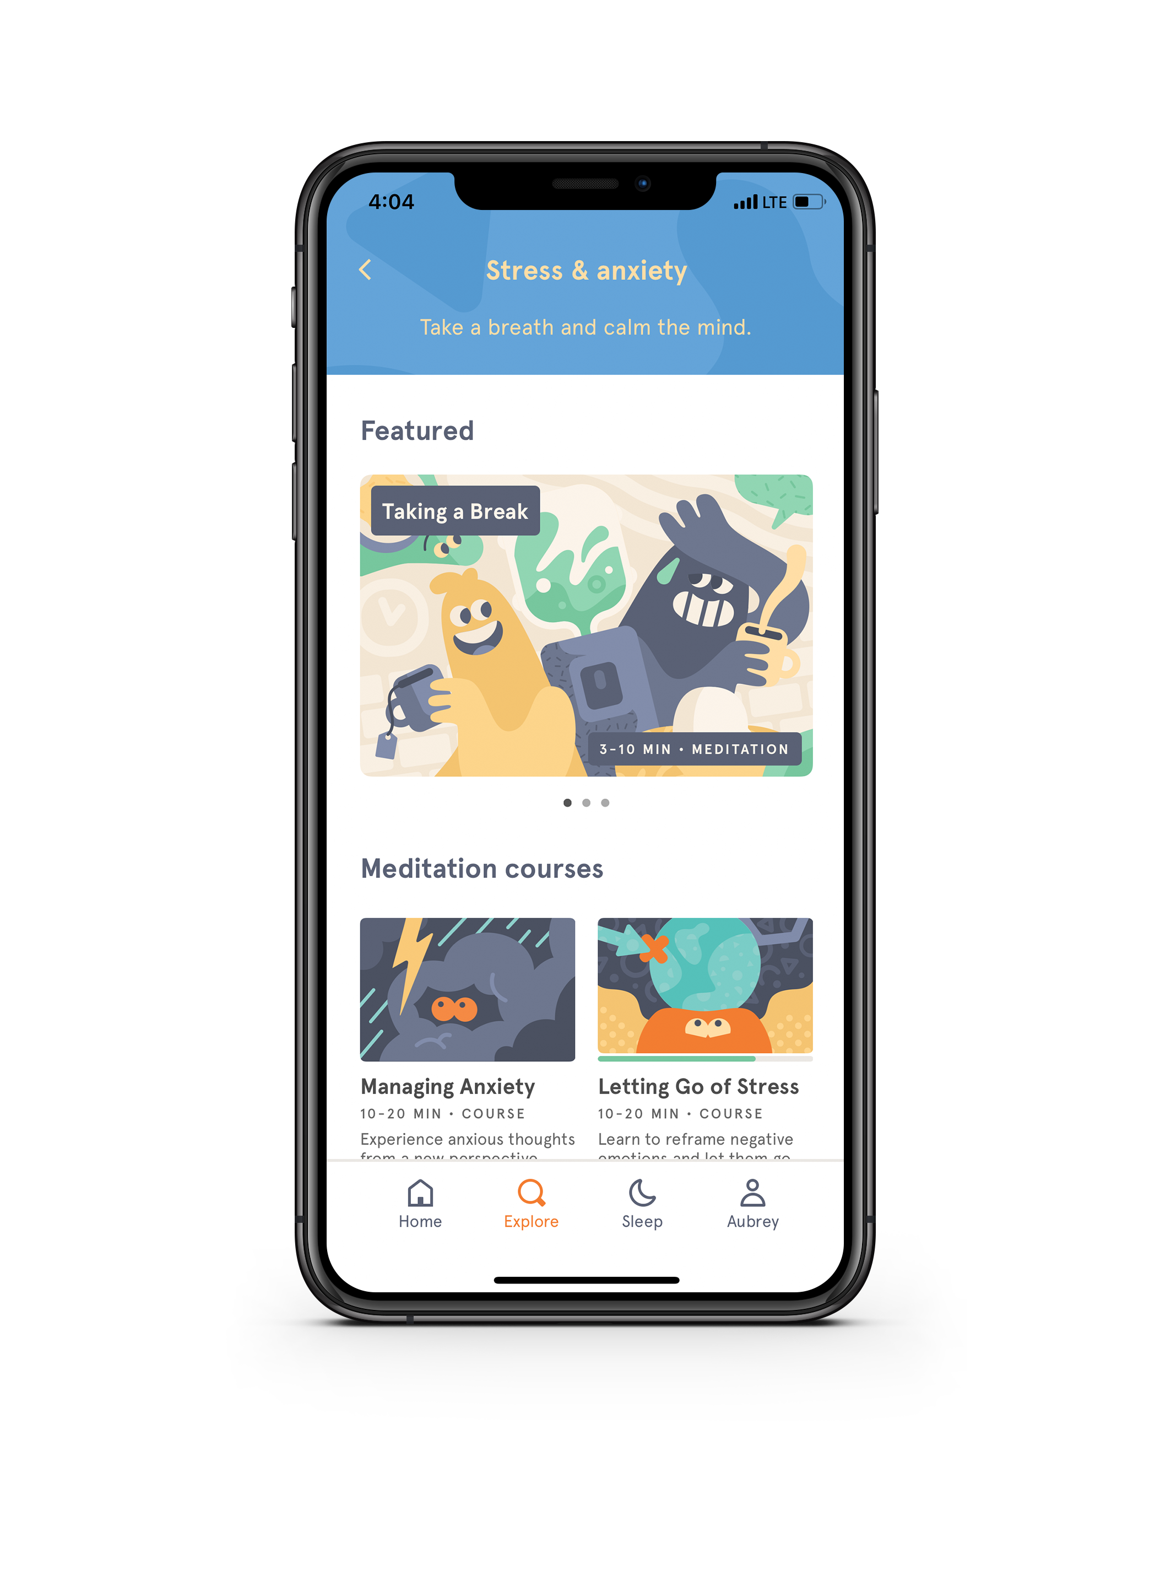
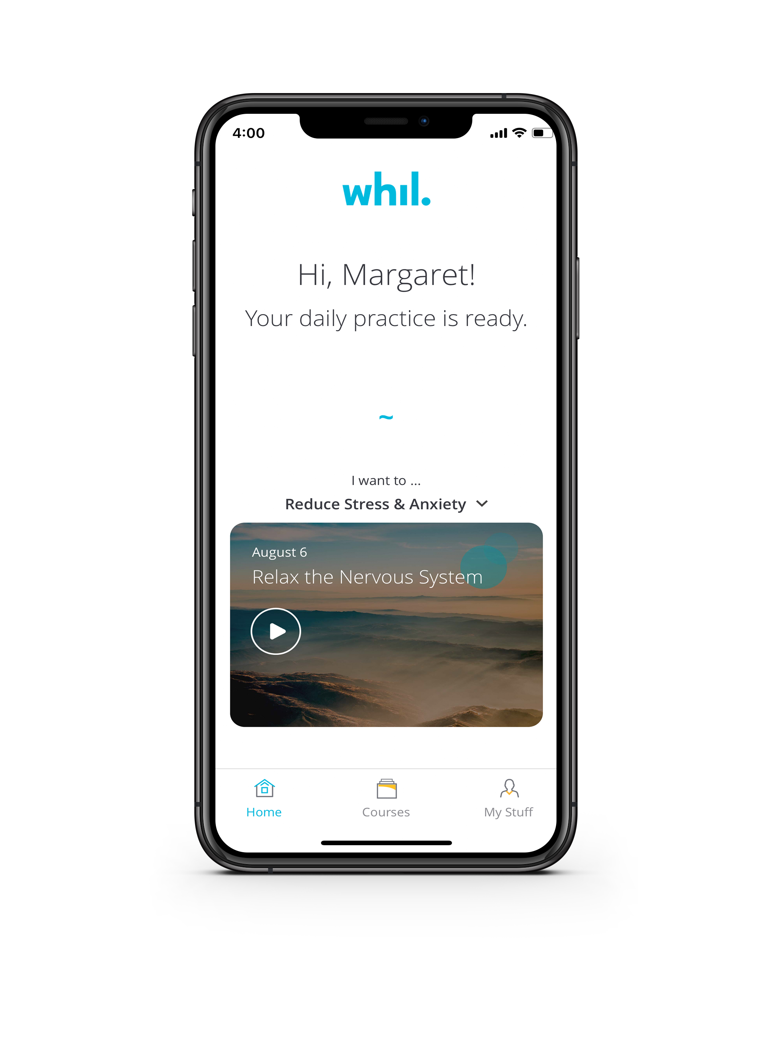
Digital Therapies: Mindfulness/Meditation
Tranquil, soothing, nature-y
Wide variety of content: Meditations, music/sounds, sleep stories, masterclasses, stretching videos
Fun, educational
Meditation education: Guided meditations, advice videos, sleep casts/ stories and music
Business, professional
Goal-specific meditations, yoga videos
For those who want a variety of audio content
Enjoys nature sounds/scenery
Likes music for relaxation, sleep, focus
Interested in learning
For those who want to learn more about mindfulness and meditation
Interested in building daily meditation practice
Want to learn about mindfulness
Young, techy
Enjoys illustrated visuals
Have limited time
For those who want goal-specific guided meditation
Likes to set goals
Likes structure
Prefers real people in videos
Has work/performance-related goals
“Serious” personality
Notes:
Note:
6 Digital Therapy apps which are NOT designed as teletherapy; however, to offer “skill building” support for our members who meet the criteria “mild to moderate” acuity

Slide 3
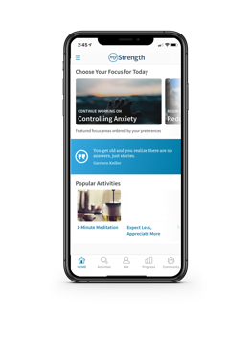
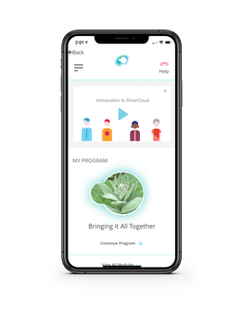
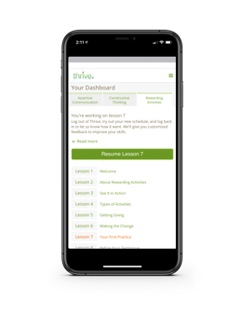
Digital Therapies (continued)
Educational
Wide variety of programs with different variety of media: Lessons, videos, inspirational quotes, mood tracker
Educational, clinical
CBT education with coach
Tools like journaling, diary, ”did you know” quizzes
Core Program:
Comorbid Anxiety & Depression
Educational, direct, action oriented
CBT education personalized with questionnaires
3 Modules: Assertive Communication, Constructive Thinking, Rewarding Activities
Navigator
Coach
For those who want access to a lot of content for a wide variety of issues
Wants knowledge
Would benefit from a coach/navigator
Likes motivational quotes
Prefers a combination of video and text
Likes personal stories
Wants to track their mood
For those who want to learn more about depression/anxiety
For those who learn by video and have needs specific to the 3 modules
Would benefit from a coach
Wants to set a goal with a coach
Learns by reading
Is comfortable with the terms and find comfort in learning more about: Anxiety, Depression
Prefers a guided approach
Learns by watching video
Is able and willing to complete activities outside of app
Wants to improve communication skills
Wants to reframe negative thoughts
Notes:
Notes:
-MyStrength has a “LIVE” person (through messaging) and the therapeutic offerings are on-going
-SilverCloud has a “LIVE” person (through messaging) and offers an 8 week program where a Coach (has a background in mental health and motivational interviewing) will keep track of your progress and make recommendations for next option in digital therapy or otherwise
Our digital therapies are “evidenced based”, and as we’ve conducted our own research we know that these Apps will be beneficial to our members.
Therapy apps which are NOT designed as teletherapy; however, to offer “skill building” support
All Apps are currently “complimentary” to members in 2020 and future monetary renderings will be nominal
LIVE in 6 service areas in SCAL and in process to roll-out in other 7 areas before the end of 2020.

Slide 4
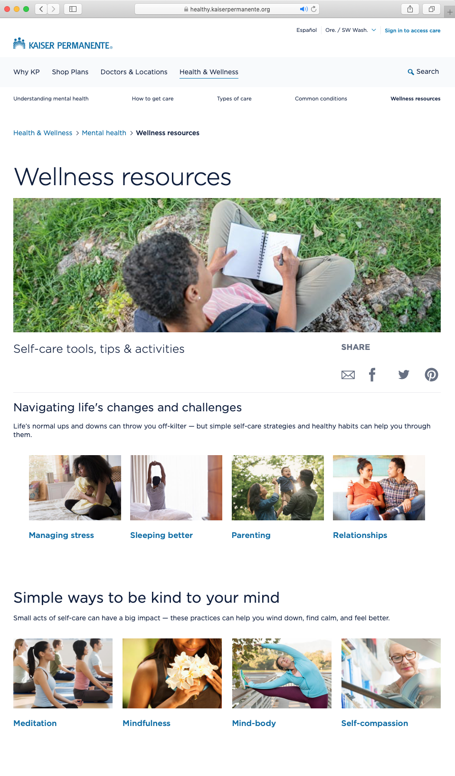
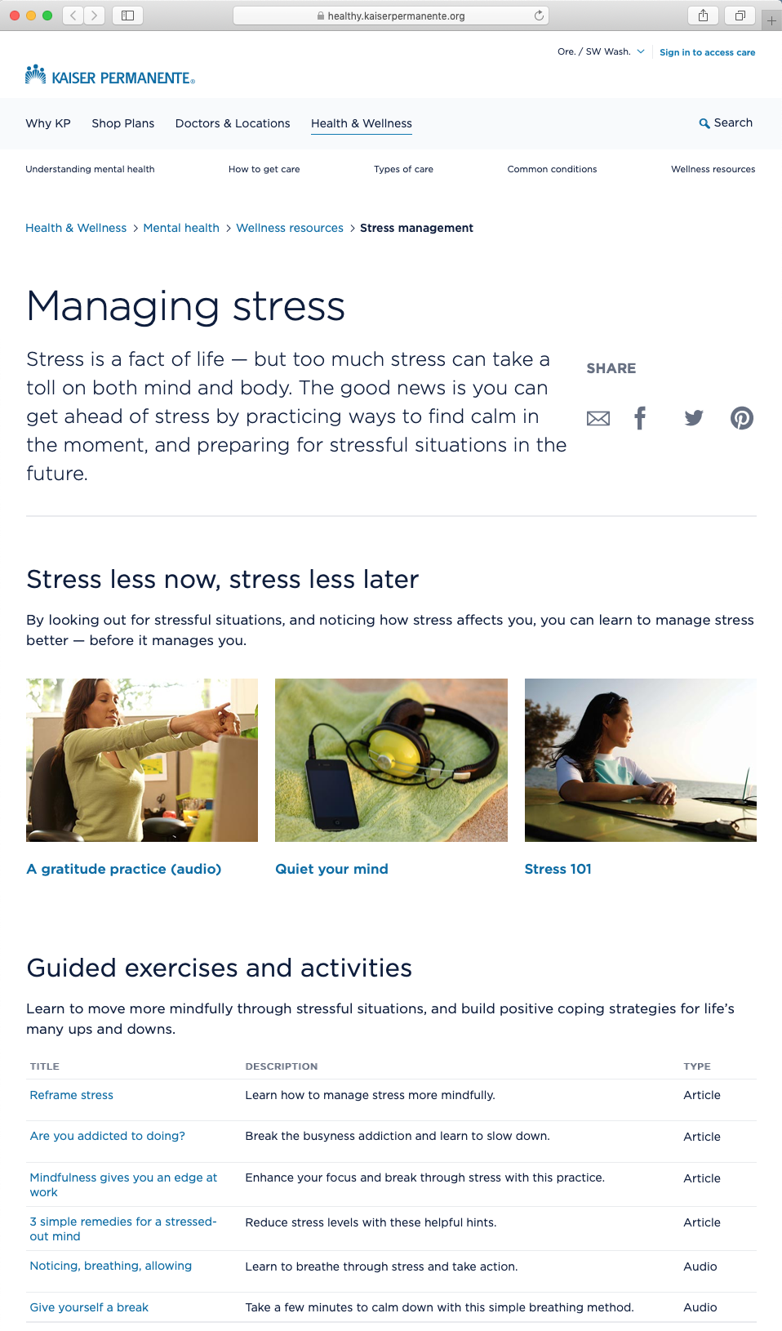
Additional online resources on kp.org
We’ve introduced new user-friendly educational and activity-based articles, audio and video content on the Mental Health and Wellness resources site on our patient facing portal kp.org. All content has been clinically reviewed.
Clinicians can now refer members, via KP Health Connect, to these resources by topic:
Life Challenges
Managing Stress
Sleeping Better
Parenting
Relationships
Techniques
Meditation
Mindfulness
Mind-Body Connection
Self-Compassion
Notes:
Note:
Kp.org offers additional articles and tutorial guides to support in a variety of areas listed under: Life Challenges and the Techniques suggested for emotional support

